Slide 1
NCEP Status Update for GODEX-NWP-2
Jeff Ator
NOAA/NWS/NCEP/EMC
November 27, 2018

Slide 2
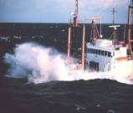
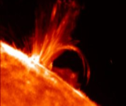
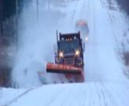
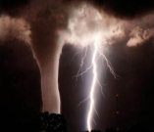
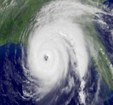
Topics
Overview of NCEP Centers and Structure
High Performance Computing
Observational Data Usage
Current
Recent changes
Future plans
NWP Model Upgrades
Recent changes
Future plans

Slide 3
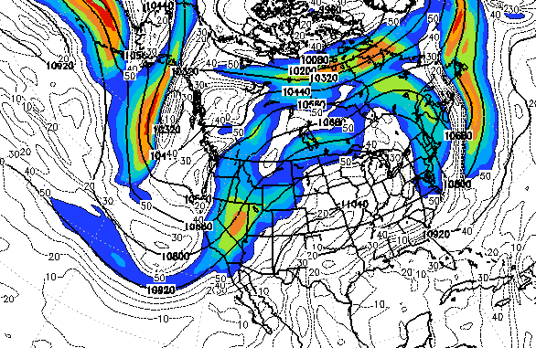
National Weather Service National Centers for Environmental Prediction
9 NCEP Centers
24x7 Operations
COOP/Backup Plans
Common Dissemination Framework
Global Data Domain
Runs at 99.9% Delivery Reliability
Aviation Weather Center Kansas City, MO
Climate Prediction Center
College Park, MD
Environmental
Modeling Center
College Park, MD
National Hurricane Center
Miami, FL
NCEP Central Operations
College Park, MD
(Supercomputers in
Reston & Orlando)
Ocean Prediction Center
College Park, MD
Space Weather
Prediction Center
Boulder, CO
Storm Prediction Center
Norman, OK
Weather Prediction Center
College Park, MD
Mission: Reliable, timely, and accurate analyses, guidance, forecasts, and warnings for the protection of life and property and the enhancement of the national economy
Vision: Nation’s trusted source, first alert, and preferred partner for environmental prediction services

Slide 4
NCEP Operational Numerical Guidance supports the NWS Agency Mission
Models provide guidance
Prediction is now inherently linked to numerical models.
Most models are run at NCEP.
More than 20 major simulation codes.
More than 1600 support codes and scripts.
Billions of data ingested daily.
Millions of products delivered daily.
Sharing with world wide partners:
U.S. Navy and Air Force, MSC, ECMWF, UK Met Office, JMA, BoM, etc.
Forecasts are made by people
122 Weather Forecast Offices (WFOs), spread across 6 geographic regions
Service Centers within NCEP
Weather Prediction Center (WPC)
Ocean Prediction Center (OPC)
Storm Prediction Center (SPC)
Aviation Weather Center (AWC)
National Hurricane Center (NHC)
Climate Prediction Center (CPC)
Space Weather Prediction Center (SWPC)

Slide 5
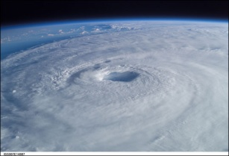
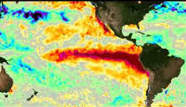
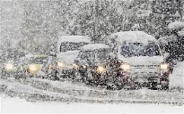
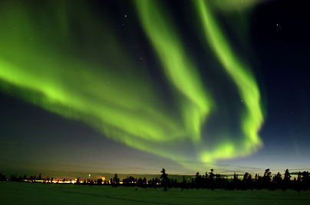
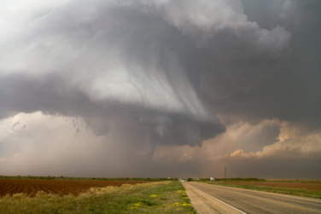
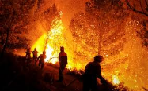
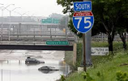
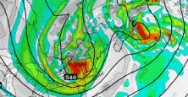
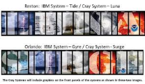
NCEP is a Critical Component of the NWS Collaborative Forecast Process
“Provision of Services from the Sun to the Sea”
Solar Monitoring, Warnings and Forecasts (SWPC)
Aviation Forecasts and Warnings (AWC)
Extreme Events (Hurricanes, snowstorms, excessive rain; severe & fire weather) (NHC, WPC, SPC)
High Seas Forecasts and Warnings to day-5 (OPC)
Week 3 & 4; Seasonal Outlooks; El Nino – La Nina Forecasts (CPC)
Model Development, Implementation and Applications for Global and Regional Weather, Climate, Oceans and Space Weather (EMC)
Super Computer, Workstation and Network Operations (NCO)
5

Slide 6
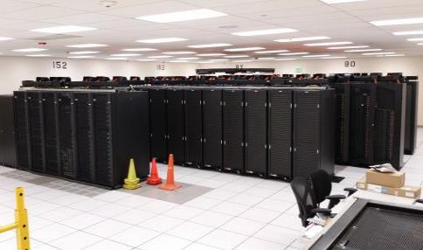
Weather & Climate Supercomputing System (WCOSS)
Location
Primary
Reston, VA (IBM provided facility) – Tide, Luna, Mars
Backup
Orlando, FL (IBM provided facility) – Gyre, Surge, Venus
Configuration
Current contract through 2021
Identical Systems (per site)
IBM iDataPlex/Nextscale (Tide/Gyre)
CRAY XC-40 (Luna/Surge)
Dell C6320 (Mars/Venus)
4.98 petaflops peak speed
14.0 petabytes of disk storage
Performance Requirements
Minimum 99.9% Operational Use Time
Minimum 99.9% On-time Product Generation
Minimum 99.0% Development Use Time
Minimum 99.9% System Availability
Failover tested regularly
Inputs and Outputs
Processes over 3.6 billion observations/day
Produces over 15 million products/day
Significance
Where United States weather forecast process starts for the protection of lives and livelihood
Produces model guidance at global, national, and regional scales
Examples:
Hurricane Forecasts
Aviation / Transportation
Air Quality
Fire Weather
Notes:
6

Slide 7
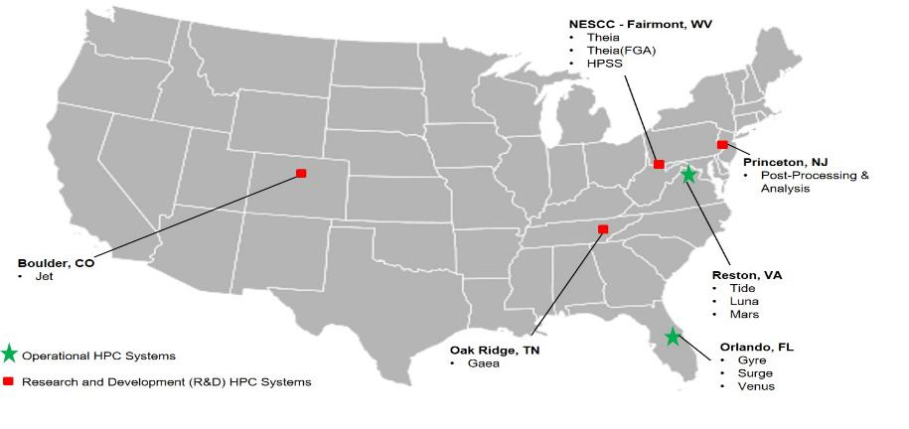
NOAA Research & Development Supercomputing
Supplemental HPC resources, including for easier collaboration with users outside of WCOSS community.

Slide 8
Conventional Data Received
NCEP 00Z GDAS ANNUAL DAILY MEAN RECEIVED CONVENTIONAL OBS
TOTAL COUNT
Thousands

Slide 9
Conventional Data Usage
bold black: used; aqua italicized: monitored
Observation type | Global Forecast System (GFS/GDAS) | North American Mesoscale (NAM/NDAS) | Rapid Refresh (RAP) | Real-Time Mesoscale Anal. (RTMA)
Tropical cycle bogus | pstnl (storm center), uv
Rawinsonde (TAC) | pstn, Tv, q, uv, sst | pstn, Tv, q, uv, sst | pstn, Tv, q, uv
PIBAL | uv | uv | uv
Dropsonde | Tv, q, uv | Tv, q, uv | Tv, q, uv
Dropsonde splash-level | pstn, Tv, q | pstn, Tv, q | pstn, Tv, q
RECCO | Tv, q, uv | Tv, q, uv | Tv, q, uv
AIREP | Ts, uv | Ts, uv | Ts, uv
AMDAR (TAC+BUFR) | Ts, q, uv | Ts, q, uv | Ts, q, uv
U.S./Mexican/ADS-C MDCRS | Ts, q, uv | Ts, q, uv | Ts, q, uv
Canadian AMDAR | Ts, uv | Ts, uv | Ts, uv
TAMDAR | Ts, q, uv | Ts, q, uv | Ts, q, uv
S. American AMDAR | Ts, q, uv | Ts, q, uv | Ts, q, uv
GPS-met (ground based) | PWt (US only) | PWt (US only) | PWt (US only)
RASS | Tv | Tv | Tv
NPN wind profiler | uv | uv | uv
Multi-agency profiler |  | uv (< 400 mb) | uv
VAD winds | uv (RCM) | uv (RCM+L2 NEXRAD) | uv (RCM+L2 NEXRAD)
JMA wind profiler | uv (currently not processed)
SYNOP (TAC), METAR | pstn, Tv, q, uv, sst | pstn, Tv, q, uv, sst | pstn, Tv, q, mta_cld, uv | pstn, Tv, q, uv, sst
Ship (TAC), buoy (TAC), platforms | pstn, Tv, q, uv, sst | pstn, Tv, q, uv, sst | pstn, Tv, q, uv | pstn, Tv, q, uv, sst
Mesonet |  | pstn, Tv, q, uv | pstn, Tv, q, uv | pstn, Tv, q, uv
mta_cld - METAR cloud amount, height of cloud base,
present weather, visibility, dewpoint
pstn - station (surface) pressure PWt - total column precipitable water
q – specific humidity
sst - sea-surface temperature Ts - sensible (dry bulb) temperature Tv - virtual temperature u v - wind

Slide 10
Non-Conventional Data Received
NCEP 00Z GDAS ANNUAL DAILY MEAN RECEIVED NON-CONVENTIONAL OBS
TOTAL COUNT
Millions
Notes:
AIRS, IASI, CrIS biggest contributors

Slide 11
Non-Conventional Assimilated Data
NCEP 00Z GDAS ANNUAL DAILY MEAN ASSIMILATED NON-CONVENTIONAL OBS
TOTAL COUNT
Millions

Slide 12
Non-conventional Data
Usage
bold black: used; aqua italicized: monitored
Instrument/product | Global Forecast System (GFS) | North American Mesoscale (NAM) | Rapid Refresh (RAP)
AMSU-A | NOAA-15/18/19(+RARS) METOP-A/B(+RARS) AQUA | NOAA-15/18/19(+RARS) METOP-A/B(+RARS) AQUA | NOAA-15/18/19(+RARS) METOP-A/B(+RARS)
MHS | NOAA-18/19 METOP-A/B | NOAA-18/19 METOP-A/B | NOAA-18/19(+RARS) METOP-A/B(+RARS)
HIRS-4 | NOAA-19 METOP-A/B | NOAA-19 METOP-A/B | NOAA-19 METOP-A/B
AIRS-281 chn, every f-o-v | AQUA | AQUA
IASI-616 chn | METOP-A/B(+DBRTN+RARS) | METOP-A/B
SSM/IS UPP radiances | DMSP F-17/F-18 | DMSP F-17/F-18
GOES sounder radiances | GOES-15 (over water) | GOES-15 (over water) | GOES-15 (over water)
SEVIRI/CSR | METEOSAT-10/METEOSAT-8 | METEOSAT-10/METEOSAT-8
ATMS | S-NPP(+DBRTN) NOAA-20 | S-NPP
CrIS-399 chn | S-NPP(+DBRTN) NOAA-20 | S-NPP
CrIS-431 chn | S-NPP NOAA-20
CrIS-2211 chn | S-NPP NOAA-20
SAPHIR radiances | Megha-Tropiques
GOES imgr cloud products |  | GOES-13/15/16 (LaRC) | GOES-13/15/16 (LaRC)
GOES sndr cloud products |  | GOES-15 (NESDIS) | GOES-15 (NESDIS)
SBUV ozone | NOAA-19

Slide 13
Non-conventional Data
Usage (cont.)
bold black: used; aqua italicized: monitored
Instrument/product | Global Forecast System (GFS) | North American Mesoscale (NAM) | Rapid Refresh (RAP)
GOME ozone | METOP-A/B
OMI ozone | AURA
MLS ozone | AURA (not currently available)
NEXRAD L2 radial wind |  | yes | yes
NEXRAD L2 reflectivity |  | yes | yes
GPS-RO bending angle | COSMIC-1 (FM1, FM6) GRACE-B METOP-A/METOP-B (GRAS) Terra-SAR-X TanDEM-X | COSMIC-1 (FM1, FM6) GRACE-B METOP-A/METOP-B (GRAS) Terra-SAR-X TanDEM-X
AMV’s LW-IR | GOES-13/15/16 HIMAWARI-8 METEOSAT-11/10/8 AQUA/TERRA (MODIS) NOAA-15/18/19/20 (AVHRR) METOP-A/B (AVHRR) S-NPP (VIIRS) | GOES-13/15/16 HIMAWARI-8 METEOSAT-11/10/8 AQUA/TERRA (MODIS) NOAA-15/18/19/20 (AVHRR) METOP-A/B (AVHRR) S-NPP (VIIRS) | GOES-13/15/16 HIMAWARI-8 METEOSAT-11/10/8 AQUA/TERRA (MODIS)
AMV’s SW-IR | GOES-13/15/16 | GOES-13/15/16
AMV’s WV-cloud top | GOES-13/15/16 HIMAWARI-8 METEOSAT-11/10/8 AQUA (MODIS) | GOES-13/15/16 HIMAWARI-8 METEOSAT-11/10/8 AQUA (MODIS) | GOES-13/15/16 HIMAWARI-8 METEOSAT-11/10/8 AQUA (MODIS)
RTMA/URMA: METOP-A & -B ASCAT used; AMVs (same as NAM) used at & below 850 mb; GOES-13/15 effective cloud amount

Slide 14
Non-conventional Data
Usage (cont.)
bold black: used; aqua italicized: monitored
Instrument/product | Global Forecast System (GFS) | North American Mesoscale (NAM) | Rapid Refresh (RAP)
AMV’s WV-deep layer | GOES-13/15/16 HIMAWARI-8 METEOSAT-11/10/8 AQUA (MODIS) | GOES-13/15/16 HIMAWARI-8 METEOSAT-11/10/8 AQUA (MODIS) | GOES-13/15/16 HIMAWARI-8 METEOSAT-11/10/8 AQUA (MODIS)
AMV’s Visible | GOES-13/15/16 HIMAWARI-8 METEOSAT-11/10/8 | GOES-13/15/16 HIMAWARI-8 METEOSAT-11/10/8 | GOES-13/15/16 HIMAWARI-8 METEOSAT-11/10/8
ASCAT scatterometer | METOP-A/METOP-B | METOP-A/METOP-B
Lightning (long & short range) |  | yes | yes
RTMA/URMA: METOP-A & -B ASCAT used; AMVs (same as NAM) used at & below 850 mb; GOES-13/15 effective cloud amount

Slide 15
Changes in Observational Data Usage
01 August 2017
NESDIS NPP VIIRS weekly real time 4 km global GVF (Green Vegetation Fraction) (updated daily)
04 August 2017
U. S. TAMDAR assimilated in RAP
23 August 2017
Level 3 & Level 2.5 NEXRAD radial wind no longer assimilated by NAM and RAP GSI.
13 September 2017
The remaining Alaska NOAA Profiler Network sites turned off
11 October 2017
Urbanet MESONET are being ingested and processed, but not yet assimilated by an NWP network

Slide 16
Changes in Observational Data Usage (cont.)
21 December 2017
GOES-16 AMV’s (IR long-wave, WV, imgr clear-sky, VIZ, WV imgr cloud-top and IR short wave) ingested and monitored in GFS and GDAS.
GOES-16 1x1 FOV cloud from NASA/LANGLEY ingested and assimilated by RAP and NAM/NDAS GSI
GOES-16 Imager Effective Cloud Amount (Sky Cover) from U. Wisc. ingested
NPP OMPS Bufr Version 8 Total Column (TC) and Nadir Profile (NP) ozone ingested
BUFR format AMDAR and Korean AMDAR available for GFS and GDAS networks
U. S. TAMDAR monitored in GFS and GDAS networks
South American AMDAR monitored in all NWP networks
08 January 2018
GOES-13 turned off

Slide 17
Changes in Observational Data Usage (cont.)
28 February 2018
Meteosat-11 AMVs ingested and assimilated in all networks
10 May 2018
NOAA-20 (JPSS-1) ATMS data ingested and monitored
NOAA-20 (JPSS-1) CrIS Full Spectral Radiance Subset 431 Channel data ingested and monitored
NPP VIIRS SST data
Great Lakes ice concentration data from National Ice Center ingested
31 July 2018
NESDIS Hazard Mapping System (HMS) Smoke new fire point data
29 October 2018
Version 2 Blended Global Biomass Burning Emissions Product (GBBEPx) NetCDF files ingested

Slide 18
Future plans: Observational Data
Test existing obs data for future assimilation:
Jason-3 altimeter SSHA, wind/wave
Surface wind speed from satellite altimetry data (all sources)
HDOB (high-density hurricane aircraft reccos), SMFR peak surface wind speed
Additional U.S. mesonet data (e.g., CRN, Coop)
Improved roadway data, utilize Clarus QC information
TAC to BUFR: SYNOP, Upper-air, SHIP, BUOY
GPM-CORE GMI radiances, precipitation retrievals
Sentinel-3A SSHA
AMSR-2 radiances and SST
NASA aeronet sfc-based AOD
GNSS (European) + U.S. surface-based GPS ZTD
S-NPP VIIRS radiances, AOD, smoke, dust
Direct readout of AIRS, AMSU-A, HIRS-4, MHS radiances and MODIS/AVHRR POES winds all from UW/CIMSS; ASCAT from RARS/EARS

Slide 19
Future plans: Observational Data (cont.)
Acquire new obs data for testing:
Dual METOP-A/-B AMV’s
Aeolus ADM
GOES-R (CSR/ASR/ABI radiances, GLM lightning, AOD, dust/smoke)
Surface-based GPS ZTD from other sources (e.g., Australia)
NPP Limb Profiler ozone data
METOP-C L1b AMSU/MHS data
GOES-17 AMV’s
NOAA-20 VIIRS Polar Winds
Notes:
DONE

Slide 20
Major Model Upgrades (Observations, Resolution, DA, Dynamics, Physics, Post-processing)
June-December 2017
Air Quality Model (AQM)
Global Forecast System (GFS)
National Blend of Models (NBM)
Hurricane Weather and Research Forecast (HWRF)
Hurricanes in a Multi-scale Ocean-coupled Non-hydrostatic (HMON) model (new - replacing GFDL Hurricane Model (GHM))
High-Resolution Ensemble Forecast (HREF)
Great Lakes Wave (GLW)
Extra-tropical Storm Surge (ETSS), including new Probabilistic Extra-tropical Storm Surge (P-ETSS)
Real-Time Mesoscale Analysis (RTMA)/Unrestricted Mesoscale Analysis (URMA), including new RTMA with Rapid Updates (RTMA-RU) every 15 minutes

Slide 21
Major Model Upgrades (cont’d) (Observations, Resolution, DA, Dynamics, Physics, Post-processing)
January-October 2018
Nearshore Wave Prediction System (NWPS)
National Water Model (NWM)
Probabilistic Tropical Cyclone Storm Surge (P-Surge)
Hurricane Weather and Research Forecast (HWRF)
Hurricanes in a Multi-scale Ocean-coupled Non-hydrostatic (HMON) model
Rapid Refresh (RAP)/High-Resolution Rapid Refresh (HRRR)
Great Lakes Ocean Forecast System (GLOFS)
Global Ensemble Forecast System (GEFS)/North American Ensemble Forecast System (NAEFS)
See http://www.nco.ncep.noaa.gov/pmb/changes/ for more information/details about any of these upgrades

Slide 22
Coming Soon: FV3-based Global Forecast System (GFS)
FV3 = Finite-Volume Cubed-Sphere Dynamical Core, developed by the NOAA Geophysical Fluid Dynamics Laboratory (GFDL)
More details available at https://www.gfdl.noaa.gov/fv3/
NCEP plans to replace the current GFS (which uses a spectral dynamical core) with an FV3-based GFS
Target implementation date is 20 January 2019
13km resolution, 64 layers (same as current GFS)
Some advancements to data assimilation
Similar physics to current GFS, but new cloud microphysics
FV3 GFS data is available at http://para.nomads.ncep.noaa.gov

Slide 23
NGGPS FV3-based Unified Modeling System Vision for Community
Mission of FV3 Community: Improve environmental modeling forecast capability unified across time and space for both research and operations
Develop the next generation of scientists
Conduct research for improved scientific understanding and innovation
Engage with community to improve transition of research to operations
Build the world’s best operational capability
The FV3 community will be guided by:
Shared goals, objectives and “ownership” with transparent governance
Inclusive and collaborative development, testing and evaluation
Balance of operational, research and end-user needs and priorities
Scientific capability and credibility
Strong partnership between research and operations
The FV3 community “layers”:
Broad research community; super users; core development team; & operations
Unprecedented opportunity to develop and advance a world-class unified modeling system for the Nation!

Slide 24
Thank You!! Questions ???
Where America’s Climate, Weather, Ocean, and Space Prediction Services Begin”
“From the Sun to the Sea…
Where America’s Climate, Weather, Ocean and Space Weather Services Begin”

